Slide 1
Digital Business Technologies
Communication Infrastructure

Slide 2
Overview of communication
Communication Basics
Internet communication

Slide 3
Communication Basics
Sender
Receiver
Messages
Signal: (analog , digital)
Medium (wire, air, cable, optical fiber)
Limited capacity (bandwidth in bits/second)
distance
transmission errors
propagation speed: time until first bit is received
packets
Needs PROTOCOL

Slide 4
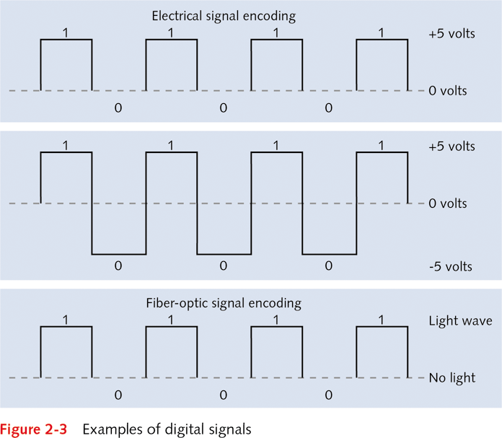
Signal
Data....Digital Signals
0
1
0
1
1
0
0
1
0
0
1
0
binary signaling
Cat...
0011 0010
1110 0110
1011 1111
Notes:
4

Slide 5
Medium
There are several kinds of communications links.
Wire
Twisted pairs
Coaxial cables
Fiber optics
Wireless
Microwave transmission
Satellite transmission

Slide 6
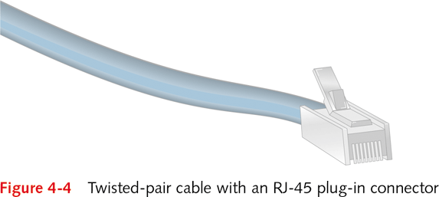
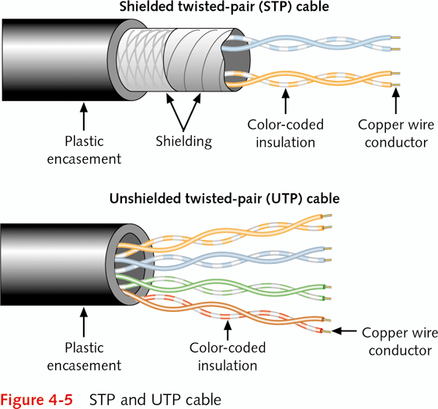
Medium
twisted pair:
light source
Notes:
STP(Shielded Twisted Pair)
UTP(Unshielded Twisted Pair)

Slide 7
twisted pair
Twisted-pair cable
Contains pairs of insulated copper wires
Outer insulating jacket covers wires
Communication specific properties
Copper wires twisted to reduce EMI and RFI
Length: up to 100 meters
Transmission speed: up to 10 Gbps
RJ-45 plug-in connector attaches cable to device
Less expensive and more flexible than T-connectors
Two kinds of twisted pair cable: shielded and unshielded (preferred)
Category 5: 100 Mbps, 1 Gbps Ethernet
Category 6: 10Gbps
Notes:
Electromagnetic interference (EMI)
Caused by magnetic force fields
Generated by certain electrical devices
Fans, electric motors, portable heaters, air-conditioners
Radio frequency interference (RFI)
Caused by electrical devices emitting radio waves
Radio and television stations, radio operators, cable TV
Problem when frequency matches network signal

Slide 8
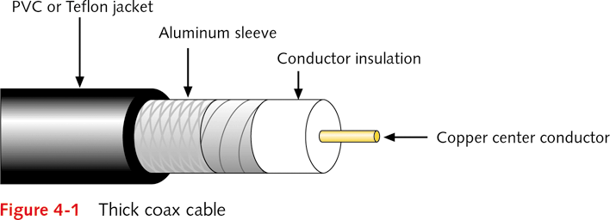
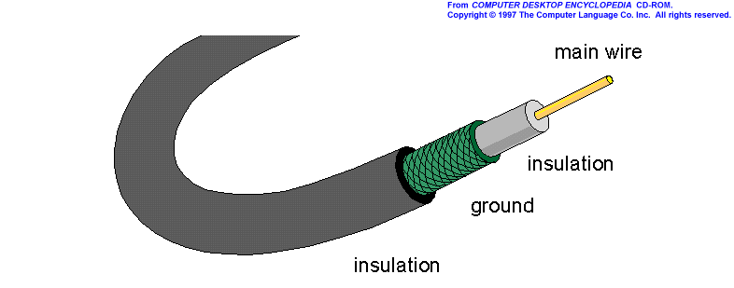
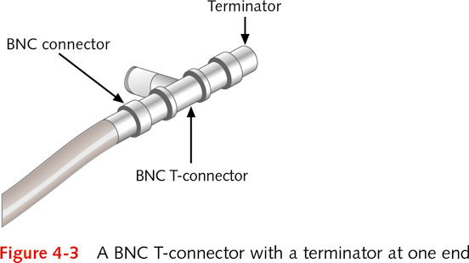
Medium
coaxial cable:
Notes:
STP(Shielded Twisted Pair)
UTP(Unshielded Twisted Pair)

Slide 9
Medium
coaxial cable:
two concentric copper conductors
bidirectional
broadband:
multiple channels on cable
HFC
1-2 Gbps in short distance

Slide 10
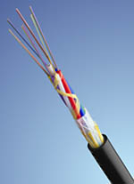
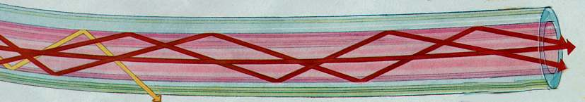
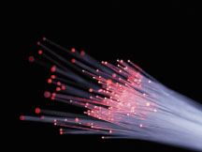
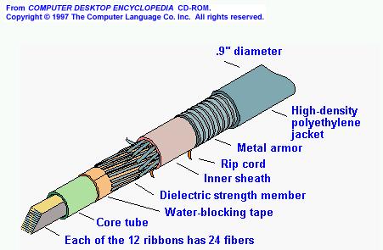
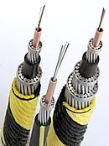
Medium
Fiber optics:
glass or plastic
cladding
plastic jacket
fiber core
TOTAL INTERNAL REFLECTION
Corning’s standard submarine cables can have up to 144 fibers in a single cable housing
light source

Slide 11
Medium
high-speed operation:
high-speed point-to-point transmission (e.g., 10’s-100’s Gbps transmission rate)
low error rate:
repeaters spaced far apart
immune to electromagnetic noise
Long-haul systems - 600 km repeater spacing
Ultra-long haul systems - 2000 km repeater spacing (forward error correction coding, fast external modulators)
Metro systems - 100 km repeater spacing
Fiber optics:

Slide 12
Advantages of optical systems
Enormous capacity: bandwidth of 37 THz!!
Low transmission loss
Optical fiber loss can be as low as 0.2 dB/km. Compare to loss of coaxial cables: 10 … 300 dB/km !
Cables and equipment have small size and weight
A large number of fibers fit easily into an optical cable
Applications in special environments as in aircrafts, satellites, ships
Immunity to interference
Nuclear power plants, hospitals, EMP (Electromagnetic pulse) resistive systems (installations for defense)
Electrical isolation
electrical hazardous environments
negligible crosstalk
Signal security
banking, computer networks, military systems
Silica fibers have abundant raw material

Slide 13
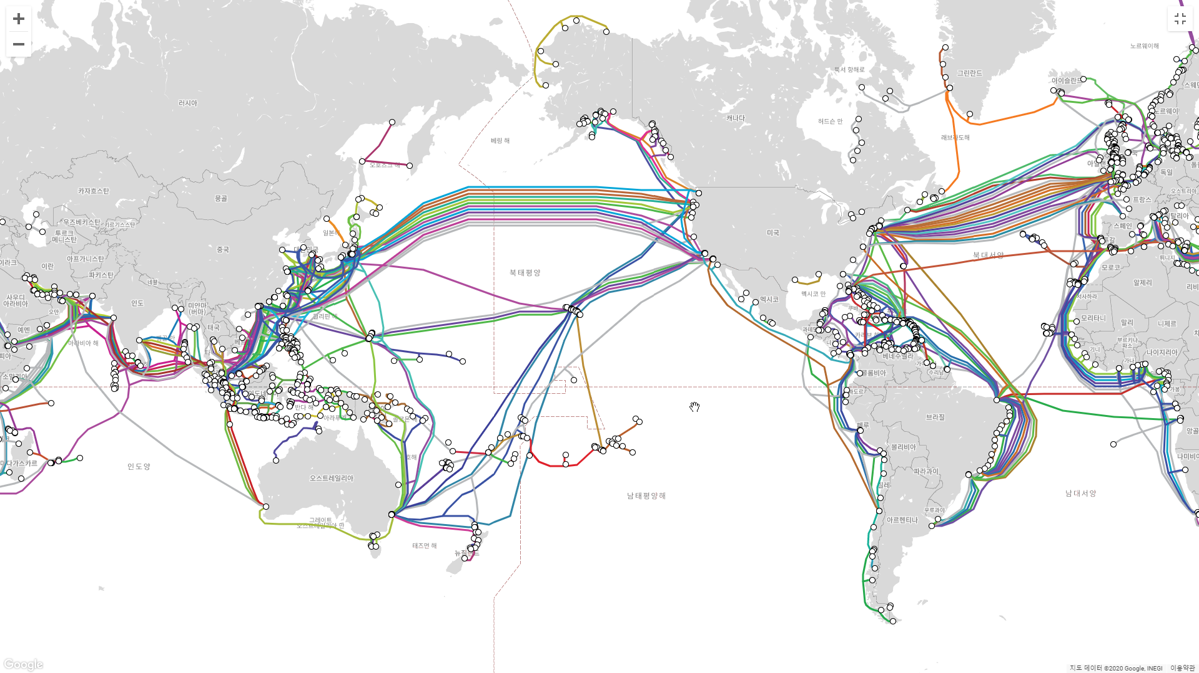
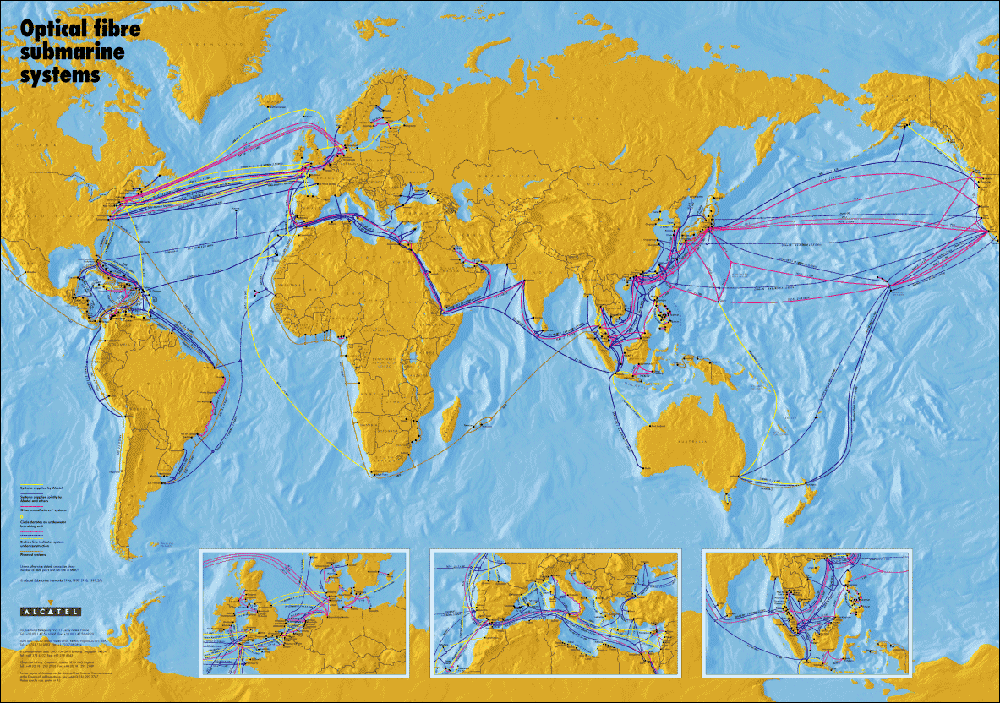
Submarine Cables in North East Asia
SOURCE: ALCATEL

Slide 14
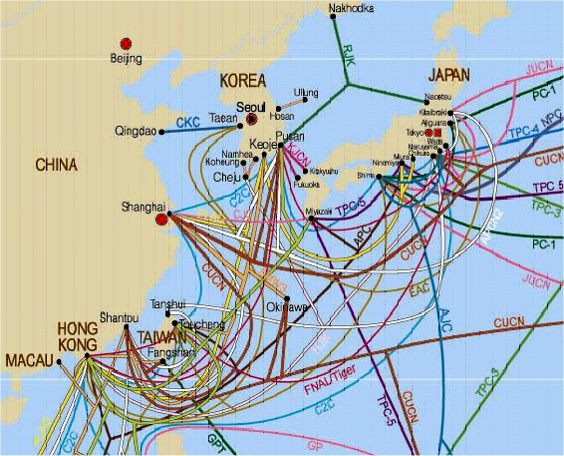
Submarine Cables in North East Asia

Slide 15
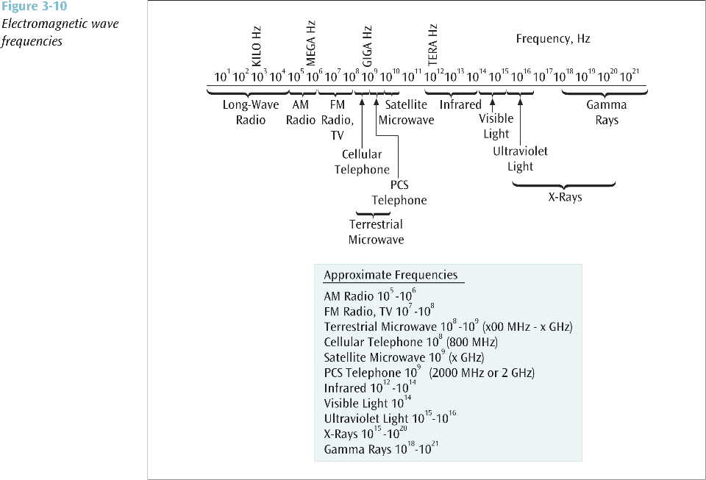
Wireless Media

Slide 16
Terrestrial Microwave Transmission
Land-based, line-of-sight transmission
Approximately 20-30 miles maximum between towers
Transmits data at hundreds of millions of bits per second
Popular with telephone companies and business to business transmissions
270 msec end-end delay
e.g. up to 360 Mbps channels

Slide 17
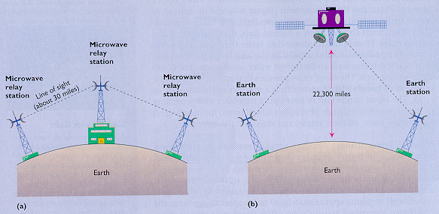
Microwave, Satellite transmission

Slide 18
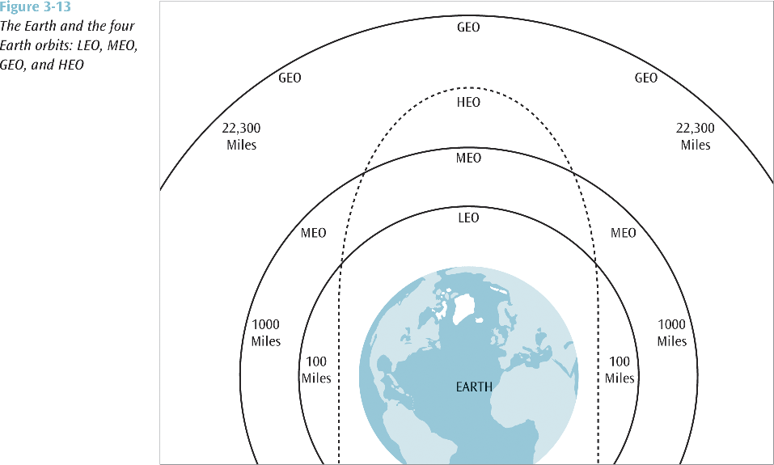
Satellite Microwave Transmission
Notes:
LEO (Low Earth Orbit) - 100 miles to 1000 miles
Used for pagers, wireless e-mail, special mobile telephones, spying, videoconferencing
MEO (Middle Earth Orbit) - 1000 to 22,300 miles
Used for GPS (global positioning systems) and government
GEO (Geosynchronous Orbit) - 22,300 miles
Always over the same position on earth (usually over the equator)
Used for weather, television, and government operations
HEO (Highly Elliptical Orbit)
Used by the military for spying and by scientific organizations for photographing celestial bodies
When satellite is far out into space, it takes photos
When satellite is close to earth, it transmits data

Slide 19
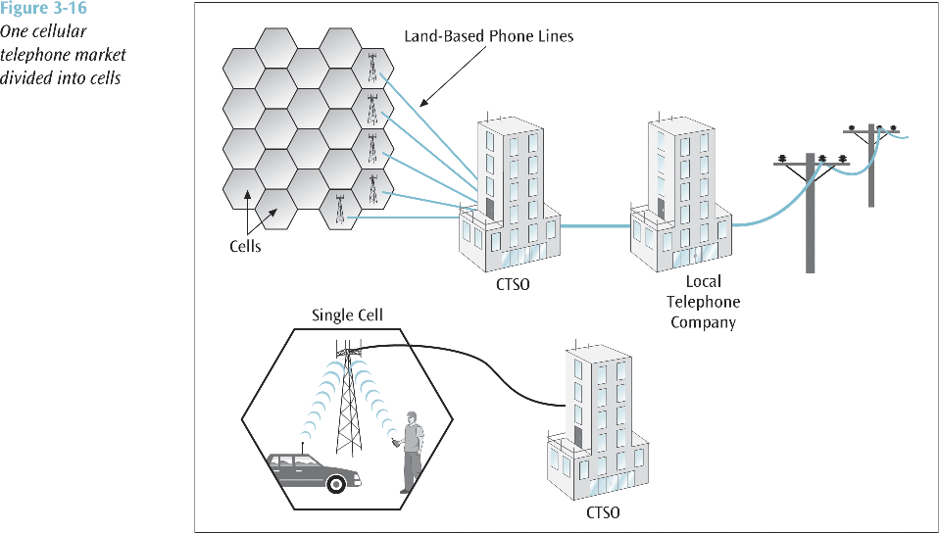
Cellular Telephone
Wireless telephone service
Also called mobile telephone, cell phone, and PCS
4G: ~ 600 Mbps (download), ~270 Mbps (upload)
5G: ~20Gbps
To support multiple users in a metropolitan area (market), the market is broken into cells
Each cell has its own transmission tower and set of assignable channels
Notes:
CTSO: cellular telephone switching office

Slide 20
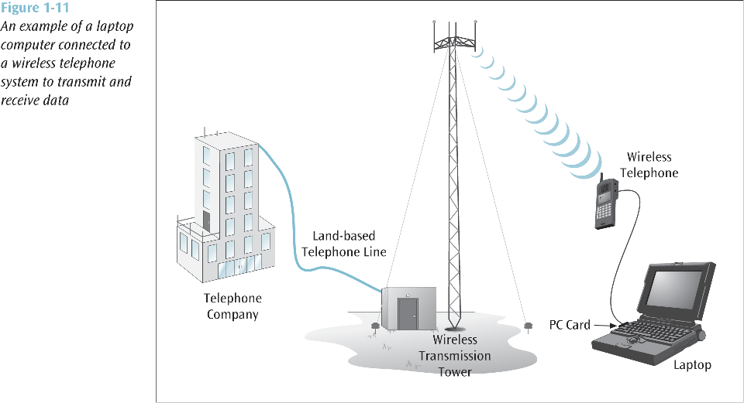
Cellular Telephone(x)

Slide 21
Bluetooth
Radio Frequency specification for short-range, point-to-multipoint voice and data transfer
Can transmit through solid, non-metal objects
Its typical link range is from 10 cm to 10 m
Can be extended to 100 m by increasing the power
Will enable users to connect to a wide range of computing and telecommunication devices without the need of connecting cables
Typical uses include phones and pagers, modems, LAN access devices, headsets, notebooks, desktop computers, and PDAs

Slide 22
Bandwidth Review(x)
Bit (b) = a unit of information, 0 or 1
10 bits can represent 1024 different messages
20 bits represent > 1 million
30 bits > 1 billion messages
The bandwidth of a communication channel = number of bits per second it transmits
All channels have limited bandwidth
One byte (B) = 8 bits (an octet)
Transmitting 1 MB at 56K bps takes 143 sec.
1 GB = gigabyte takes 40 hours
at 7Mbps 19 minutes; at 1 Gbps takes 8 seconds)
Latency = delay from first bit transmitted to first received

Slide 23
the simplest communication(x)
To transmit data between 2 computers
Each computer has FIFO queue (buffer)
Two way at the same time: full duplex
bit stream with a fixed length: packet
Packet format and rules : protocol
An example of hypothetical packet format and protocol
header
payload
0/1
address / data
0: please send the data word at “address”
1: here is the data word you asked for.

Slide 24
Multipoint Communications
Addressing problem
destination?
Impossible to connect each computer to all the others
To connect n computers, need n(n-1)/2 links
To connect 1 billion computers, need 5 x 10¹⁷ links
Need switch equipments with one billion circuits
Connect all computers to one medium? No
Capacity: too much traffic
Collision: simultaneous messages interfere
Vulnerability: pipe leaks, no one can talk

Slide 25
Shared vs switched media
Shared media (e.g., Ethernet)
Switched media (e.g., ATM)
a
b
c
d
a
c
input ports
output ports
a
b
c
d
b
switch
d
a
b
c
d
a
c
a
b
c
d
b
switch
d
Notes:
ATM: Asynchronous Transfer Mode,

Slide 26
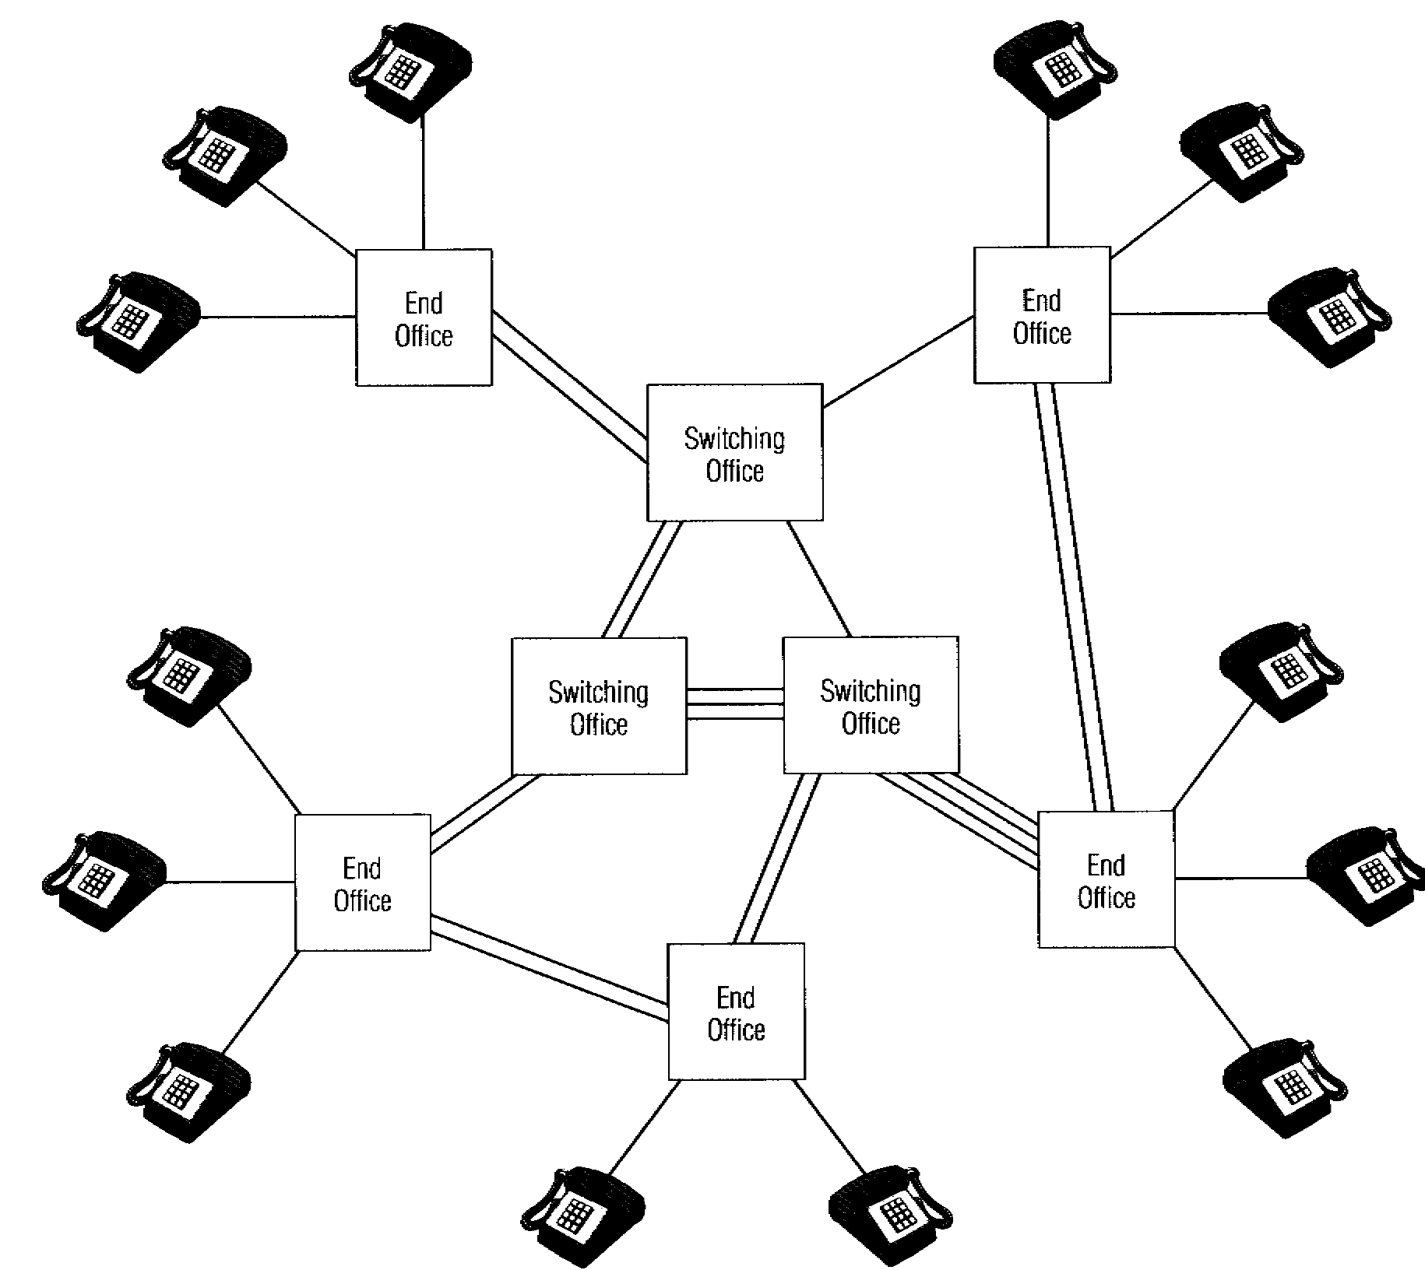
Circuit Switching v. Packet Switching
Circuit switched network
dedicated connection (circuit) between two nodes,
held open for the entire exchange
provides guaranteed capacity
cost is independent of traffic
E.g., Telephone system
Packet switched network
transmissions divided into packets (data + metainfo)
multiplexed onto high capacity intermachine connections
allows multiple concurrent communication
does not guarantee capacity
E.g., the Internet
A
Computer y
Packet
A
Message
B A
B
Computer x
B
Packet
CIRCUIT-SWITCHED NETWORK
PACKET-SWITCHED NETWORK

Slide 27
Virtual Circuits
All commercial packet switched PSDNs use virtual circuits
Eliminates forwarding decisions for individual packets
Reduces switching load, so reduces switching costs
Virtual Circuit
Notes:
PSDN: Packet Switched Data Network

Slide 28
Network Topologies(x)
More than two computers causes complications:
Each machine on a network must have a unique address
If machine 2 sends a message to machine 4, what tells 1, 3 and 5 to ignore it, but 4 to listen?
Ethernet protocol
1
2
3
4
5
LAN BUS TOPOLOGY
LAN = LOCAL AREA NETWORK

Slide 29
Network(x)
Two or more computers connected together:
Allows
exchange of data
separation of function (accounts receivable v. payroll)
shared services (printers, databases)
reliability
Requires
interconnection (wire, fiber, infrared, radio)
communication protocols

Slide 30
The internetworking idea (Kahn, 1972)
Creation of an internet by interconnecting distinct constituent networks (internetwork, or internet)
Each network exists already independently
No need to change the existing network in order to connect to an internet
Communicate by best-effort
Use “black boxes” (called router later) to connect constituent networks
None controls the whole network
One huge network that interconnects other networks
Addressing (which node, which network?)
Assigning a unique id to billions of nodes? (naming)
Routing path (where to send a packet?)
How to find each node? (forwarding and routing)
Packets
Arriving in wrong sequences (reorder packets)
loss (have to be retransmitted)
Include errors (correct or retransmit)
Go through many nodes (time delay)
advantages
Even if one network is down, all the others are still working
Interconnecting heterogeneous networks
problems
Provide transparency in a heterogeneous environment (Ethernet, FDDI, ATM, wireless)
How to keep a standard?

Slide 31
Structure of the Internet
NAP
Backbone 1
Europe
Backbone 4, 5, N
Japan
NAP
Regional A
Backbone 2
NAP
NAP
Backbone 3
Australia
Regional B
MAPS
UUNET MAP
KOREA
SOURCE: CISCO SYSTEMS
Notes:
Network Access Point

Slide 32















the Internet - network structure
Level 1 (interconnect level, NAPs)
Level 2 (national level, NSPs)
Level 3 (ISPs)
Level 4 (company, individual)
mobile network
PC
server
global ISP
wireless
laptop
smartphone
home
network
regional ISP
wireless
links
wired
links
institutional
network
router
Notes:
NSP: Network Service Provider that owns backbone

Slide 33
Internet characteristics
Open standard
Transmission Control Protocol/Internet Protocol (TCP/IP)
address
sequence number
message fragment
packet-switched, wide-area network
Separation of communication and Data processing
Standard organization for internet technology
IETF (Internet Engineering Task Force)
standard services: E-mail, file transfer, remote login, WWW
Transfer time
Depends on bandwidth, traffic, message length
Influenced by reordering message packets, retransmitting missing packets
Distributed control
None controls the whole internet
Each organization controls its own network
scalability
Easy to connect and disconnect
Easy to reconfigure sub-networks
Notes:
인터넷 관리
IETF(Internet Engineering Task Force): 표준 설정
IRTF(Internet Research Task Force)
IAB(Internet Architecture Board): IETF 감시, 분쟁조정
ISOC(Internet SOCiety): IETF funding, IAB 구성원 지명
IANA(Internet Assigned Number Authority)

Slide 34
Protocol Stacks - TCP/IP versus OSI
OSI
Subnet Layers
TCP/IP
Upper layer above Subnet Layer
internet: Hybrid TCP/IP Architecture
OSI
TCP/IP
internet
Application (7)
Application
Application
Presentation (6)
Session (5)
Transport
Transport
Transport (4)
Network (3)
Internet
Internet
Subnet
Data Link
Data Link (2)
Physical
Physical (1)

Slide 35
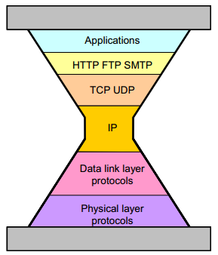
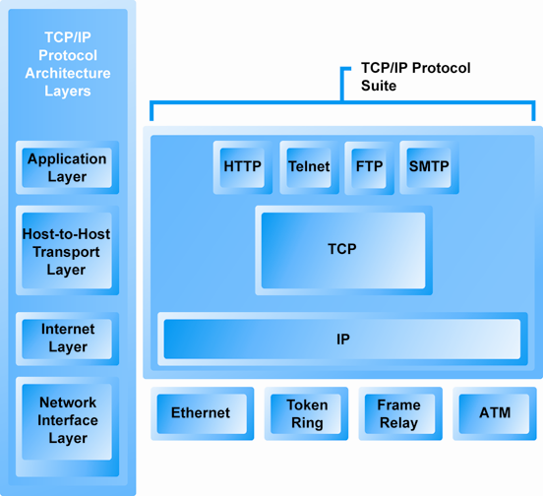
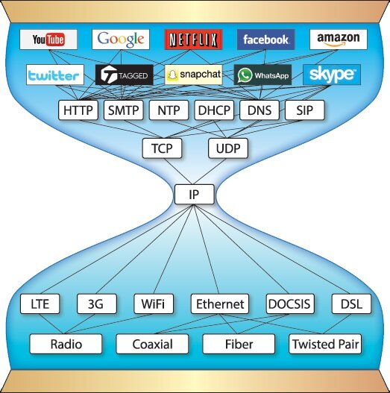
The TCP/IP Architecture and Protocol Suite

Slide 36
Internet standard protocols
Decompose Messages into
packets and assemble
Application Layer (FTP, Telnet, WWW, email)
Transport Layer(TCP, UDP)
Internet Layer(IP)
Move packet to
the destination
thru the internet
Subnet
Standards
Data Link Layer(PPP, Ethernet)
Physical Layer
PDU(protocol data unit)
Application
APDU
Application
Transport
TPDU
Transport
Internet
IPDU
Internet
Data Link
DLPDU
Data Link
User PC
Physical
Server

Slide 37
Notes:
See pages 187 and 188 of Comer book

Slide 38
Layer Cooperation
on the Source Host
on the Destination Host
Adding Headers and Trailers:
Removing Headers and Trailers:
Application
HTTP msg
Application
Transport
HTTP msg
TCP-H
segment
Transport
Internet
HTTP msg
TCP-H
IP-H
packet
Internet
Data Link
Ether-T
HTTP msg
TCP-H
IP-H
Ether-H
frame
Data Link
User PC
Physical
Webserver

Slide 39
Internet Standards
PPP
ISP
ISP
Ethernet
User PC
Webserver
Router
App
HTTP
App
Trans
TCP
Trans
Int
IP
Int
Int
IP
Int
DL
PPP
DL
DL
Ether
DL
Phy
Modem
Phy
Phy
?
Phy

Slide 40
HTTP (HyperText Transfer Protocol)
Browser
HTTP
Webserver
Program
HTML
User PC
Webserver
Universal resource locator
[protocol]://[web server address]:[port]/[directory]/[file name]
Sample HTTP Request
Sample HTTP Response
GET /report1/home.htm HTTP/1.1[CRLF]
Host:ddm.korea.ac.kr
Accept: image/gif.
Accept-Language: en
UA-pixels: 1024*768
UA-color: color16
UA-OS: Windows 98
HTTP/1.1 200 OK[CRLF] Date: Tuesday, 20-JAN-1999 18:32:15 GMT[CRLF] Server: name of server software[CRLF] MIME-version: 1.0[CRLF] Content-type: text/plain[CRLF] [CRLF] File to be downloaded.

Slide 41
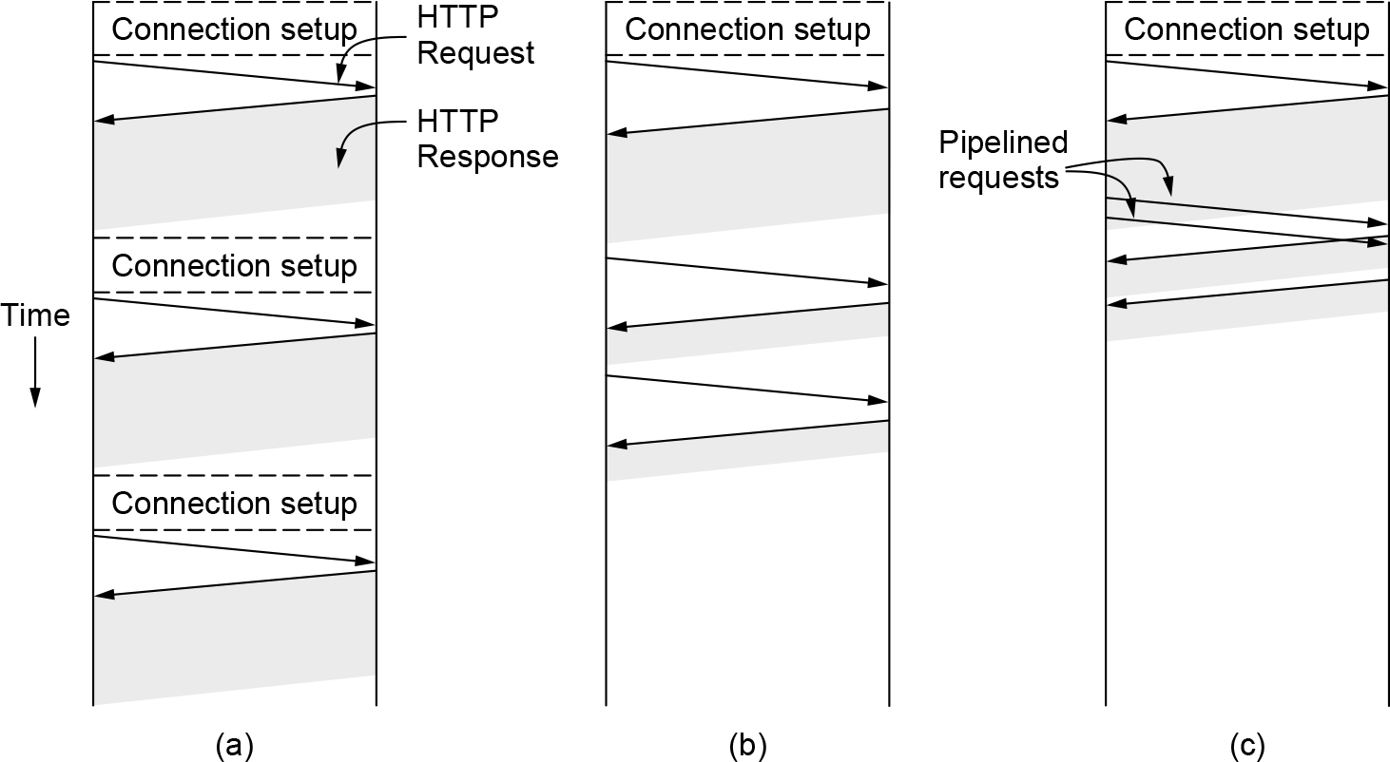
HTTP
HTTP with
(a) multiple connections and sequential requests: http/1.1
(b) A persistent connection and sequential requests.
(c) A persistent connection and pipelined requests: http/2

Slide 42
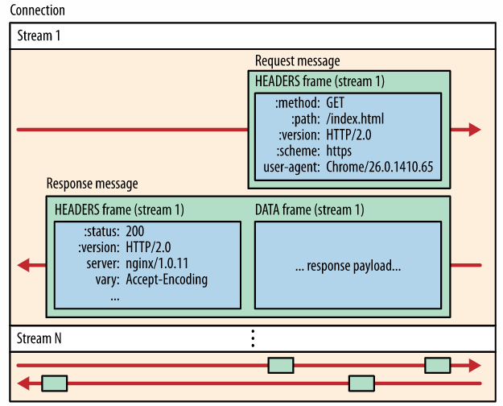
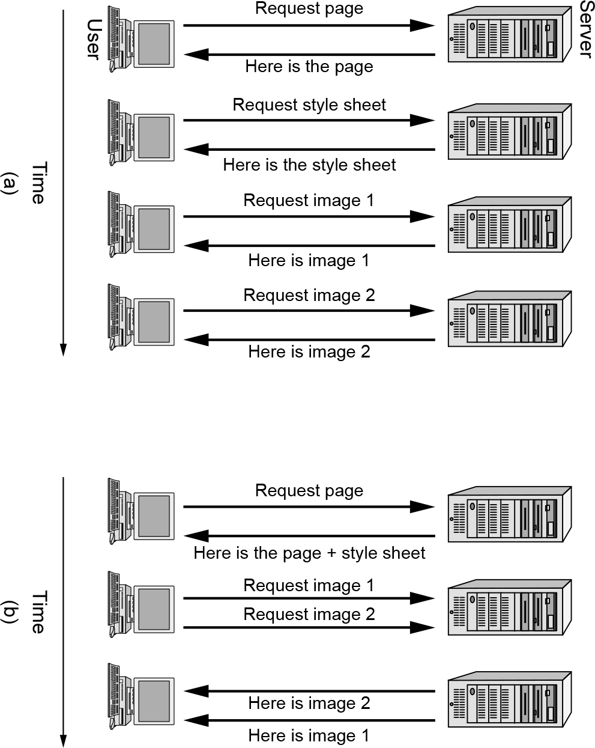
HTTP(x)
(a) Getting a Web page in HTTP/1.1
(b) Getting the same page in HTTP/2
HTTP/2
Multiplexed Streams
Stream Prioritization
Server Push
Header Compression

Slide 43
TCP (Transmission Control Protocol)
Transport layer process stores the HTTP Request Temporarily
User PC transport process opens a connection to the webserver transport layer process
Next, user PC sends the HTTP Request
Transport layer process on the webserver receives the TCP segment delivering the HTTP Request
Webserver application creates the HTTP Response message
Webserver Transport Process Delivers the Response
Closing the Connection takes 4 TCP Segments

Slide 44
TCP: Opens a Connection
User PC
Transport
Process
SYN
Webserver
Transport
Process
SYN, ACK
ACK
Three Flags are Widely Used
SYN bit set to 1 in a TCP segment to request a connection
ACK bit set to 1 in a segment to acknowledge a received TCP segment
FIN bit set to 1 in a segment to inform of a connection closure

Slide 45
TCP Segment Structure
Divided logically into sections called fields
source port field is bits 0 to 15, …
Bit 0
TCP Segment
Bit 31
Source Port # (16)
Destination Port # (16)
Sequence Number (32 bits)
Acknowledgement Number (32 bits)
Hdr Len
(4)
Reserved (6)
Flags (6)
Window Size (16)
TCP Checksum (16)
Urgent Pointer (16)
Options (if any)
PAD
Data Field

Slide 46
TCP: Request-Response
User PC
Transport
Process
TCP segment containing
HTTP Request
Webserver
Transport
Process
ACK
User PC
Transport
Process
TCP segment containing
HTTP Response
Webserver
Transport
Process
ACK

Slide 47
TCP: Closing the Connection
FIN
User PC
Transport
Process
Webserver
Transport
Process
ACK
FIN
ACK

Slide 48
TCP
ensures end-to-end delivery
fragment long application messages and transmits them in several TCP segments
implements flow control: send the next segment after receiving ack
TCP is reliable
it does error correction
Each TCP segment has a 32-bit sequence number that increases with each TCP segment a transport process sends
it Places TCP Segments in Order
protects against errors at lower layers as well as transport layer errors
Retransmit if not receiving ack after sending a segment
high-overhead
Executed only at the end nodes
Multiple HTTP Request-Response Cycles can be Handled with a Single TCP Connection in HTTP/1.1 and later versions

Slide 49
IP (Internet Protocol)
Connectionless Service
No open, close, error correction, flow control
Low overhead
Unreliable
No error handling
No sequence numbers
IP Addresses and Router Forwarding

Slide 50
Routing
Machine
2.16
Machine 1.35 wants to send a
packet to Machine 3.249.
Routers determine the path
the packet will take.
Machine
3.249
Routers
Machine
1.35
A
B
Router A can send
the packet either way
4.1
NETWORK 4 &
IT’S ROUTER
5.9
NUMBER OF ROUTES

Slide 51
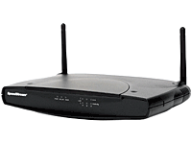
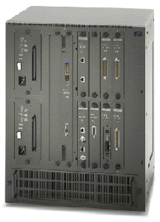
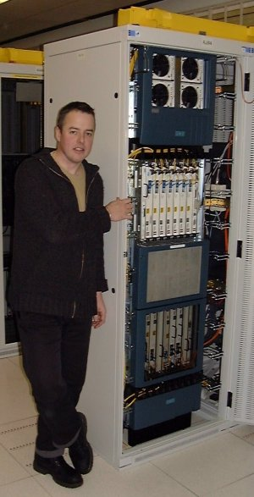
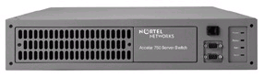
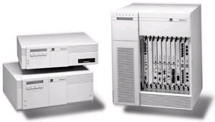
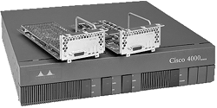
Routers
SIEMENS
NORTEL
3COM
CISCO

Slide 52
IPv4 Packet Structure
Bit 0
“type” of data
Bit 31
Version
(4)
Hdr Len
(4)
Type Of Service(8)
Total datagram Length in bytes (16)
Identifier (16 bits)
Flags (3)
Fragment Offset (13)
Time to Live (8)
Upper layer
Protocol (8)
Header Checksum (16)
Source IP Address
Destination IP Address
Options (if any)
PAD
Data Field
for fragmentation/
reassembly

Slide 53
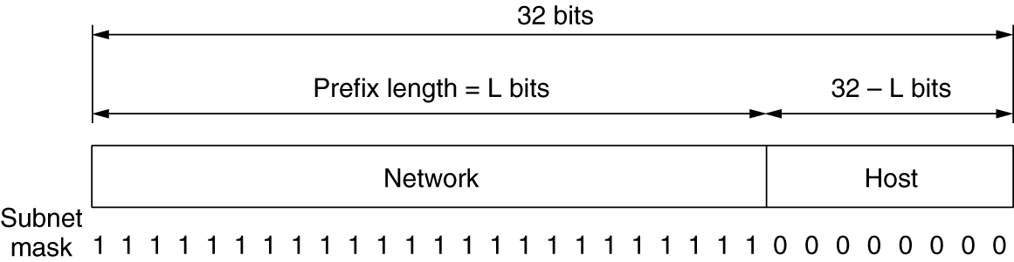
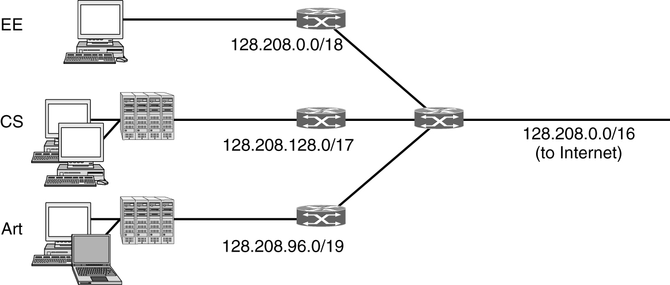
IPv4 addresses
Prefixes: Network part
Subnets: Splitting an IP prefix into separate networks with subnetting
CIDR—Classless InterDomain Routing
Classful and special addressing
NAT—Network Address Translation

Slide 54
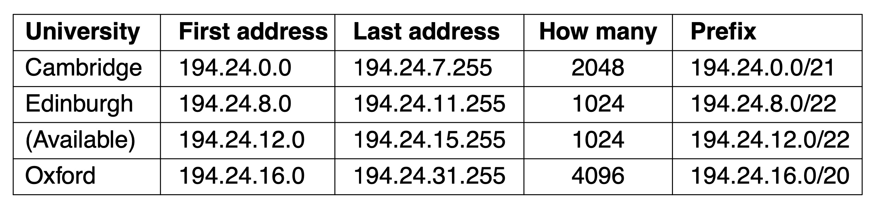
IPv4 Internet addresses
IP addresses consist of network part + host part or network part + subnet part + host part
CIDR
3 classes of addresses:
0
1
2
8
16
24
31
0
network(7)
host (24)
Class A(128 nets, 16 M hosts/net)
1
0
network (14)
host (16)
Class B(16 K nets, 65 K hosts/net)
1
1
0
network (21)
host (8)
Class C (2 M nets, 256 hosts/net)

Slide 55
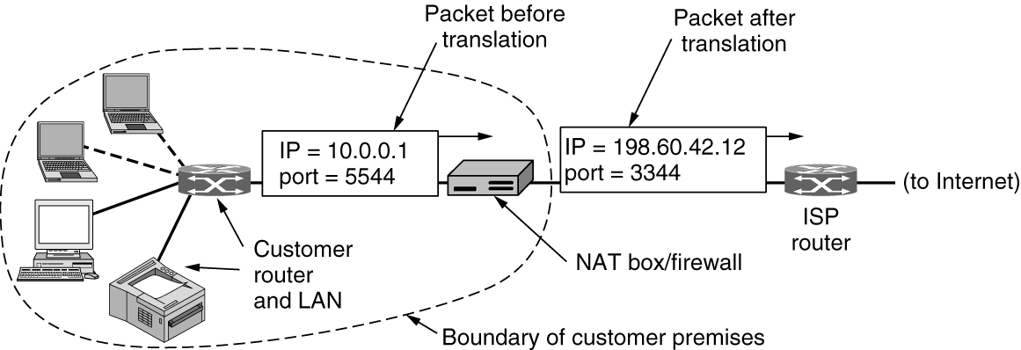
NAT
NAT
Home gateway/broadband router

Slide 56
IPv6
Longer addresses than IPv4
Simplification of the header
Better support for options
Big advance is in security
Quality of service
2001:db8:3e8:100::1
traffic class
upper layer protocol or extension header
ver
pri
flow label
payload len
next hdr
hop limit
source address
(128 bits)
Fixed Header
destination address
(128 bits)
data
32 bits

Slide 57
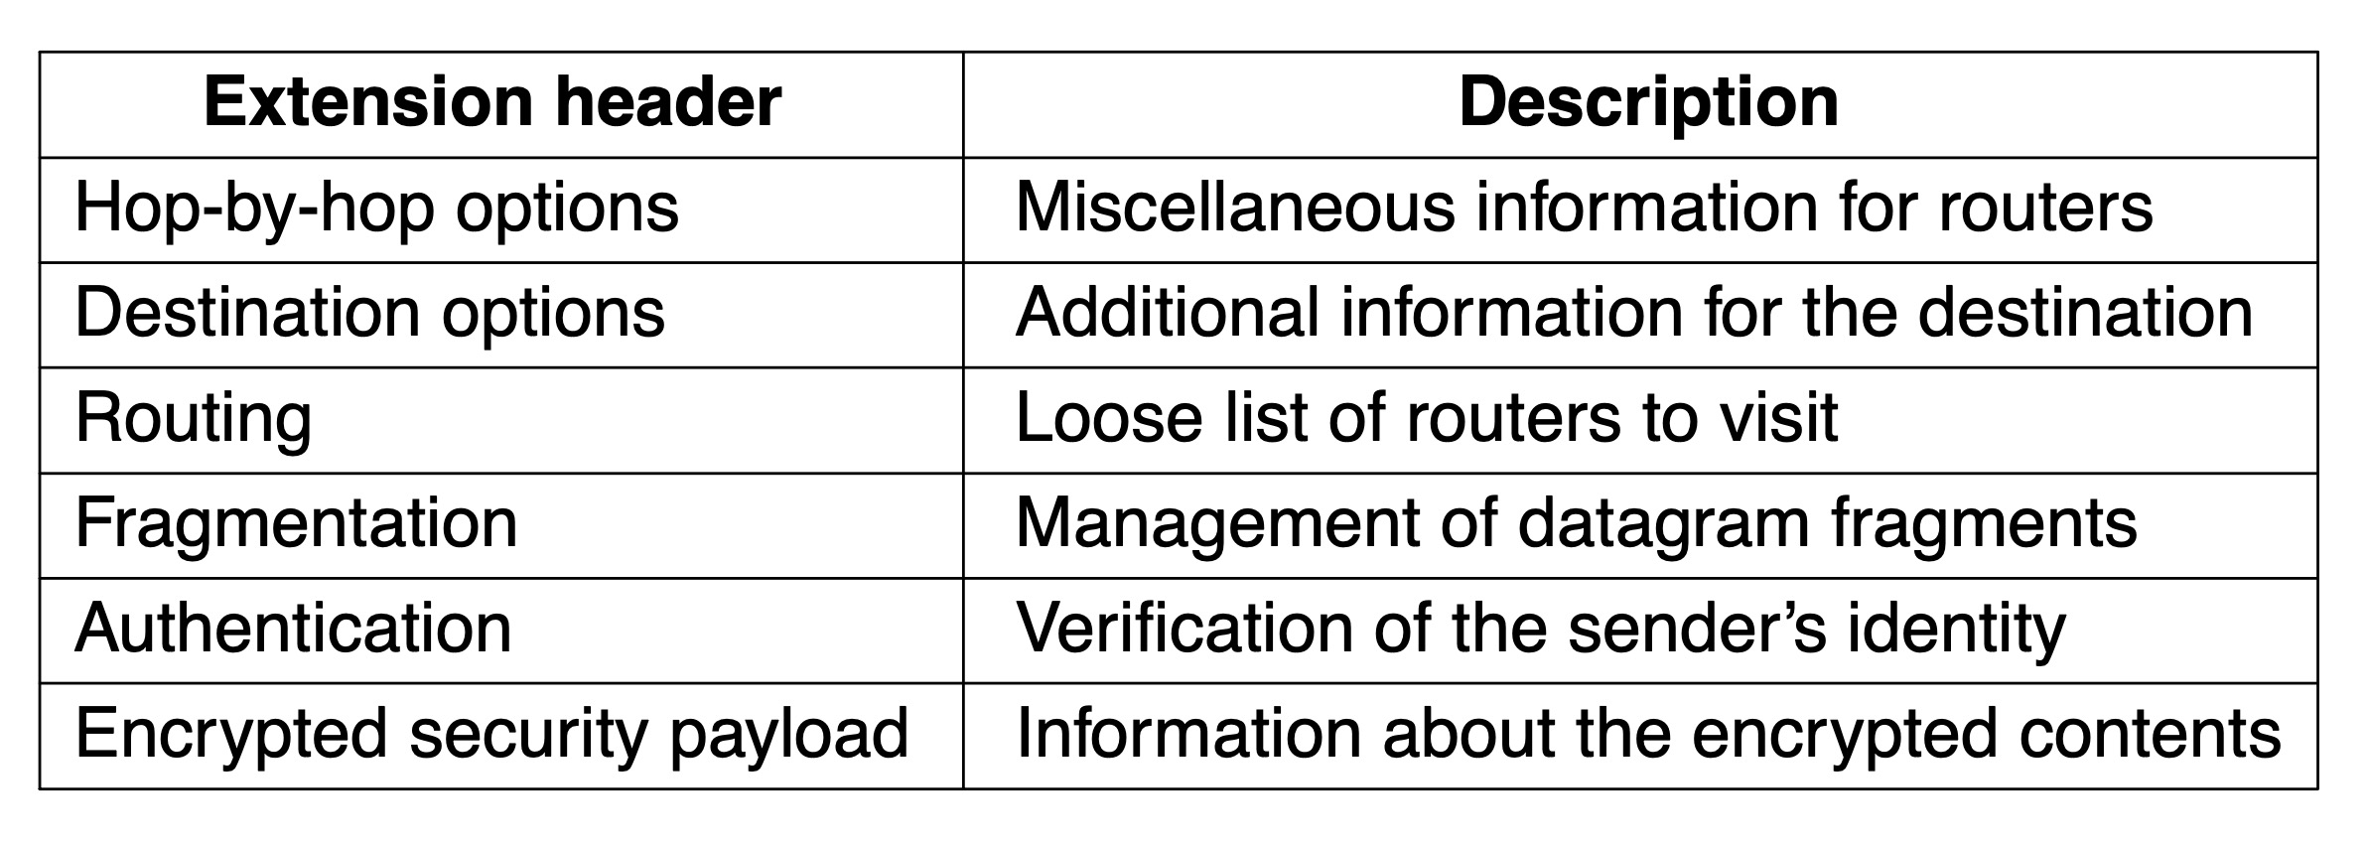
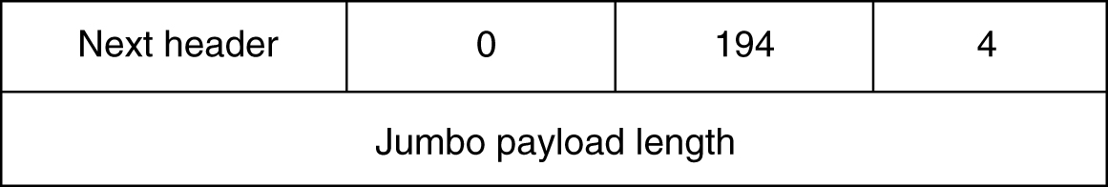
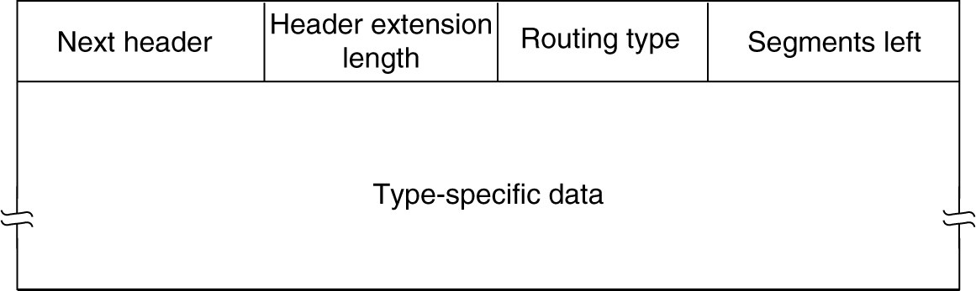
IPv6 Extension Headers
The hop-by-hop extension header for large datagrams
The extension header for routing

Slide 58
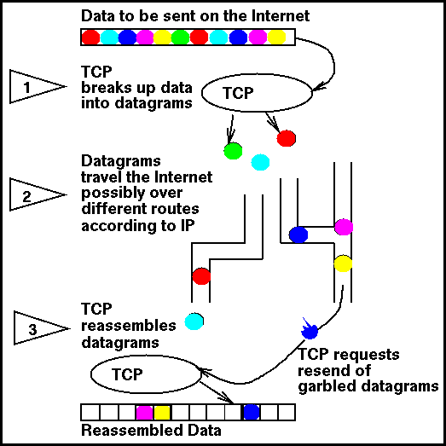
Packet Switching (TCP/IP)
TCP = TRANSMISSION
CONTROL
PROTOCOL
(Breaks messages into packets
and reassembles them)
IP = INTERNET
PROTOCOL
(Moves packets around
the Internet)
SOURCE: J. DECEMBER

Slide 59
Internet Standards - Data Link Layer
organize transmissions into collections of bits and manage their transmission within a single network
Concerned with exchange of data between an end system and the network
sending computer provides destination address
sending computer invokes services of network (e.g. priority)
separates higher layers from details of network (e.g. X.25, Ethernet, Token Ring)
only involves systems attached to same network
Frame
10010001001
Data Link

Slide 60
Ethernet frame format
64 - 1518 bytes
Preamble
Dest
addr
Src
addr
Frame
type
Payload
CRC
Postamble
64 bits
48 bits
48 bits
16 bits
368-12000 bits
32 bits
8 bits
visible from the host
Preamble: 101010101 (synch)
Dest and Src addr: unique ethernet addresses
Frame type: indicates what packet type it encapsulates
E.g. encapsulated IP packets are denoted by 0x0800
Payload: data (may include encapsulated packets of other protocols)
CRC: cyclic redundancy check (error detection/correction)

Slide 61
Internet Standards - Physical Layer
Physical Layer Standards in Internet Access from Home
connector plugs
RJ11 Wall jack, Serial port, Model port
transmission media
Telephone wire, cable
electrical signaling
External modem
Visible and tangible physical products: many suppliers can provide

